Slide 1
A Study Of The Book Of Revelation
December 27, 2020

Slide 2

Revelation 11:15
Revelation 11
“And the seventh angel sounded; and there followed great voices in heaven, and they said, The kingdom of the world is become (the kingdom) of our Lord, and of his Christ: and he shall reign for ever and ever.”

Slide 3
Seventh Trumpet – Third Woe
Revelation 11
The seventh trumpet sounded, and there were “loud voices in heaven” (NASV)
“The kingdom of the world is become (the kingdom) of our Lord.” (verse 15)
This section anticipates the fall of Rome – fourth kingdom in Daniel’s prophesy (Daniel 2:37-45; 7:14, 27).
The kingdom of God cannot be destroyed! cf. Hebrews 12:28
God’s kingdom has won!
He will reign forever!

Slide 4
Revelation 11:16
Revelation 11
“And the four and twenty elders, who sit before God on their thrones, fell upon their faces and worshipped God.”

Slide 5
Revelation 11:17
Revelation 11
“saying, We give thee thanks, O Lord God, the Almighty, who art and who wast; because thou hast taken thy great power, and didst reign.”

Slide 6
Revelation 11:18
Revelation 11
“And the nations were wroth, and thy wrath came, and the time of the dead to be judged, and (the time) to give their reward to thy servants the prophets, and to the saints, and to them that fear thy name, the small and the great; and to destroy them that destroy the earth.”

Slide 7
Defeat of Wicked Powers
Revelation 11
The 24 elders (cf. Chapters 4-5)
Prostrate themselves in worship to God
Offer thanksgiving to God in terms of His eternity and power
Take note of his royal authority …
“Because thou hast taken” – perfect tense
“and didst thou”
God has been reigning
He has now decisively dethroned evil
His kingdom has won!

Slide 8
Defeat of Wicked Powers
Revelation 11
Nations enraged – persecution
God’s wrath – vindication
Wrath of the nations, versus the wrath of God
War between God and Satan
Reflected in the rebellious world’s great assault on His church
Heathen’s anger rose – God’s wrath answered …
Divine vengeance on those who oppose Him …

Slide 9
Defeat of Wicked Powers
Revelation 11
Simple message of the 24 elders. (verses 16-18)
God is in control! Verse 17
The time for God’s wrath is come. Verse 18
God will reward His people. Verse 18

Slide 10
Defeat of Wicked Powers
Revelation 11
The conflict is described in greater detail in future visions.
The church is assured what will be the final outcome.
The saints rewarded – those who sought to destroy the kingdom – crushed and destroyed!
Do we understand who is REALLY in control?

Slide 11
Revelation 11:19
Revelation 11
“And there was opened the temple of God that is in heaven; and there was seen in his temple the ark of his covenant; and there followed lightnings, and voices, and thunders, and an earthquake, and great hail.”

Slide 12
The Temple in Heaven
Revelation 11
Whatever might come, God promises He is present and will keep His covenant with them.
Door of the temple opened in heaven (also see 4:1).
During the Mosaic period, the ark of the covenant was seen only by the High Priest on the day of atonement. (Leviticus 16)
Ark of the covenant – promises will be kept
Presence of God depicted by lightnings, noises, thunderings, an earthquake, and great hail. (Exodus 19:16, 18)

Slide 13
Revelation 11
The Temple in Heaven
The seventh trumpet announced final defeat and final victory.
Announces the outcome of the conflict before the conflict begins!
Provides an introduction to the last half of the Book of Revelation.

Slide 14
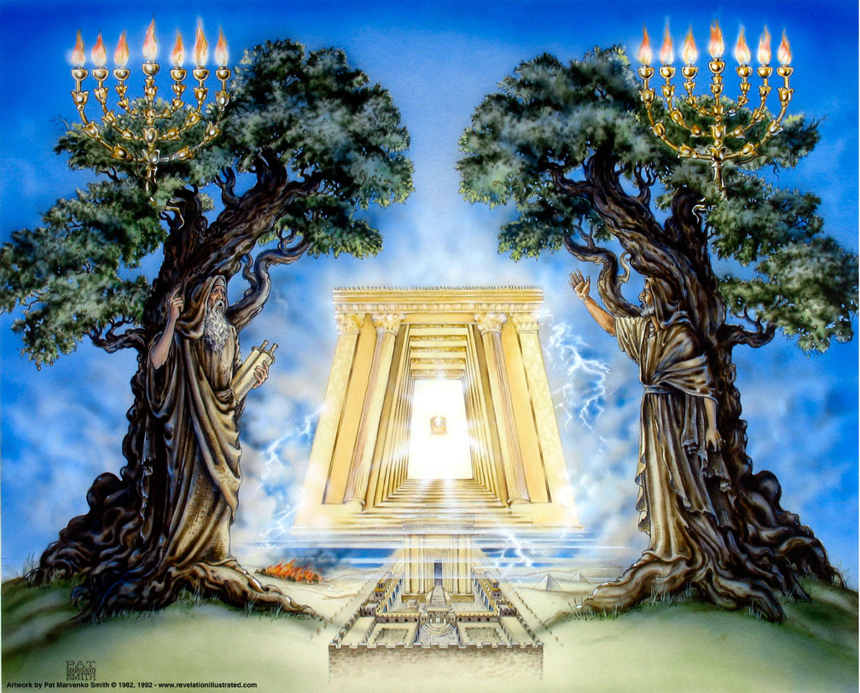
Revelation 11

Slide 15
Chapter 12

Slide 16
Resources used:
A Study Of The Book Of Revelation by Bob Dodson
More Than Conquerors by William Hendriksen
Overcoming With The Lamb, Florida College Annual Lectures, February 7-10, 1994
Revelation: An Introduction and Commentary by Homer Hailey
Revelation (Truth Commentaries) by Robert Harkrider
Revelation (A Study Workbook) by Robert Harkrider
Revelation by Donnie Rader
Revelation charts by Keith Greer.
Studies In The Book Of Revelation by Ferrell Jenkins
The Old Testament In The Book Of Revelation by Ferrell Jenkins
The Revelation Of Saint John The Divine by G.B. Caird
The Book of Revelation by Foy E. Wallace
The Avenging of the Apostles and Prophets by Arthur M. Ogden
Worthy Is The Lamb by Ray Summers
Written exchange on “The Domitian Persecution” between Arthur M. Ogden and Ferrell Jenkins presented in Searching The Scriptures, June 12, 1989, pages 7-12

Slide 17
Revelation
I. Struggle on Earth (1-11)
A. John’s Vision (1)
B. Letters to seven churches (2-3)
C. God in control (4-5)
D. Opening of seven seals (6-11)

Slide 18
Revelation
II. Christ And The Dragon In Conflict (12-22)
(Deeper Spiritual Meaning)
A. War – The Woman, the Dragon, and the Man-Child (12-14)
B. Bowls of Wrath (15-16)
C. Fall of Babylon the Harlot (17-18)
D. Victory of God’s people (19-21)
E. Warnings about the Book (22)

Slide 19
Revelation 12
Causes / Drives
1-11
Describes:
Things on
Earth
Struggle
12-22
Describes:
Forces at Work
in Spiritual
Realm

Slide 20
Revelation 12
1-11
Victory
from the
vantage point
of the
Christian / Earth
12-22
Victory
from the
vantage point
of
God / Heaven

Slide 21
Revelation 12
“The Woman and The Dragon At War”
Outline
I. The Woman, the Dragon, and the Male Child (verses 1-6)
II. War In Heaven (verses 7-12)
III. Persecution of the Woman (verses 13-17)

Slide 22
“The Woman and The Dragon At War”
Key Verse
Revelation 12:17
“And the dragon waxed wroth (enraged NASV) with the woman, and went away to make war with the rest of her seed, that keep the commandments of God, and hold the testimony of Jesus”

Slide 23
Revelation 12
What Is The Point?
It’s all a battle with Satan
Fought Against Christ
Birth
Death
Then his people

Slide 24
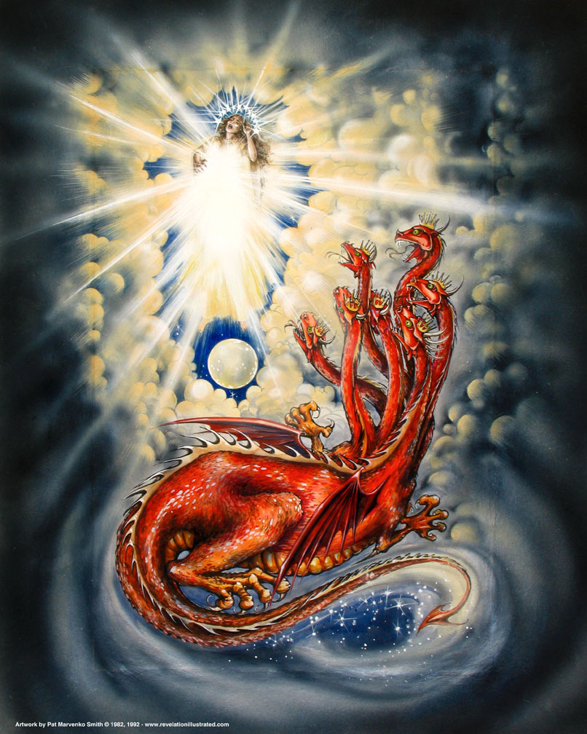
Book of Revelation: Chapter 12
Revelation 12
Basis of the Conflict – The Woman, The Dragon, and The Child

Slide 25
Deeper Spiritual Background
Revelation 12
Basic outline of Revelation:
The church’s conflict in and with the world
Chapters 1 – 11
The inner struggle between Christ and Satan
Chapters 12 – 22

Slide 26
Deeper Spiritual Background
Revelation 12
Chapter 12 begins Part 2 of the Apocalypse.
This part focuses on the sins of the empire and how complete its overthrow will be.

Slide 27
Deeper Spiritual Background
Revelation 12
Revelation was written in a recapitulation pattern …
First, the outcome is revealed; then scenes are repeated to give additional information that explains why a certain result is reached.
We should be careful not to link the chapters in chronological order.
Understand that the pageantry recapitulates earlier visions, deepening our insight.

Slide 28
Deeper Spiritual Background
Revelation 12
Part One tells about Rome’s sins against the church.
God offered her time and opportunity to repent – salvation from doom and overthrow.
First six trumpets – partial judgments against the empire
Sadly, instead of repentance, hearts hardened, and repentance became impossible!

Slide 29
Deeper Spiritual Background
Revelation 12
In the first eleven chapters:
The assured final outcome is revealed.
Characters are introduced – the beast versus God’s witnesses.
Winners are announced – Christ and the saints (church).
Several questions remain unanswered … Introduction to Chapters 12ff
Why the hostility toward the church and persecution of the saints?
From whence comes the power that motivates the persecutors?

Slide 30
Deeper Spiritual Background
Revelation 12
In the first eleven chapters:
Christ controls the world’s destiny.
He walks in the midst of the churches.
He is aware of the struggles and conflicts they face.
He has authority to carry out God’s plans.
Book opened – it summarizes, from the gospel’s first message, God’s dealings with those on earth.
Men are called to repentance.
There are warnings (trumpets). Time is running out.
A brief summary of the result in chapter 11 … stay tuned; more details will be forthcoming!

Slide 31
Deeper Spiritual Background
Revelation 12
The next eleven chapters will reveal:
Does the struggle involve just the church and Rome?
Remaining visions that show the struggle “behind the scenes.”
It actually originates in heaven.
The battle between God and Satan.
Righteousness versus evil.
The magnitude of the heavenly conflict.
The intent of Satan and his agents is real – not imagery!

